Slide 1

Note: The data and information in this document is reflective of a hypothetical situation and client. This document is to be used for KPMG Virtual Internship purposes only.
Sprocket Central Pty Ltd
Data analytics approach
[Division Name] - [Engagement Manager], [Senior Consultant], [Junior Consultant]

Slide 2



KPMG_TASK
View in Power BI
Last data refresh:
10/2/2020 7:36:42 PM India Standard Time
Downloaded at:
10/2/2020 8:38:35 PM India Standard Time

Slide 3
Note: The data and information in this document is reflective of a hypothetical situation and client. This document is to be used for KPMG Virtual Internship purposes only.
Agenda
Introduction
Data Exploration
Model Development
Interpretation

Slide 4
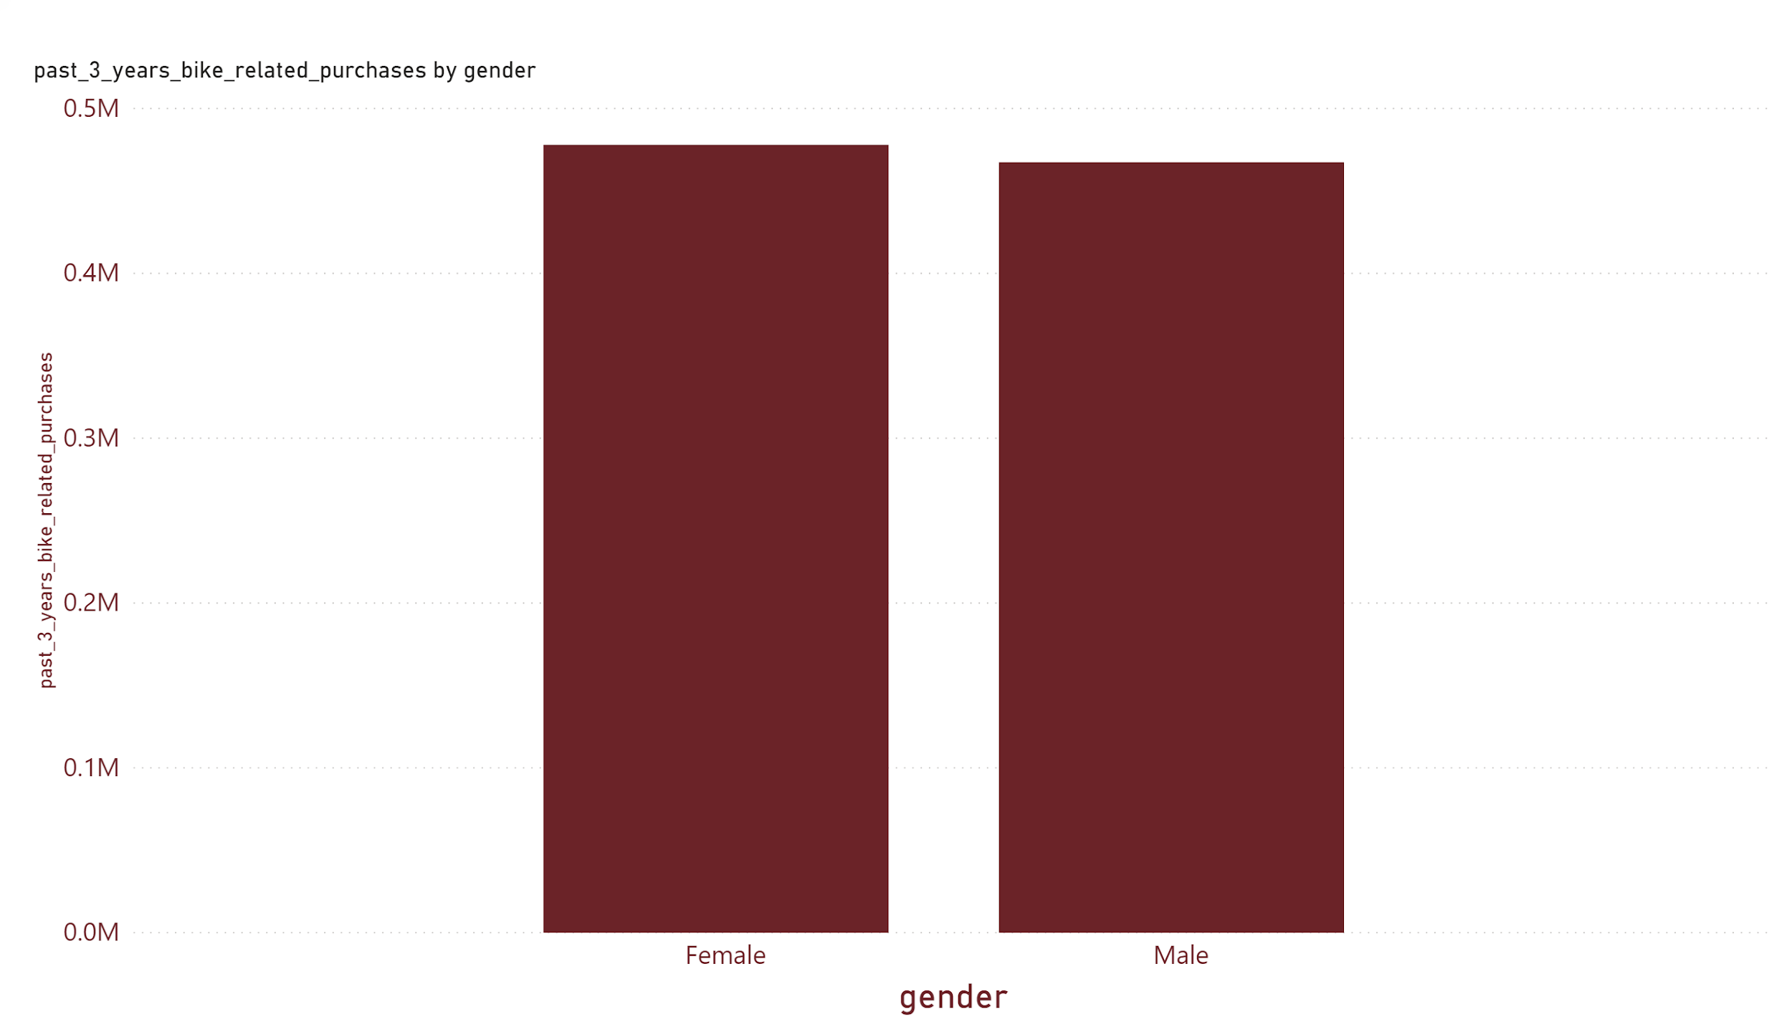
Notes:
In past 3 years female purchased more bikes than male

Slide 5
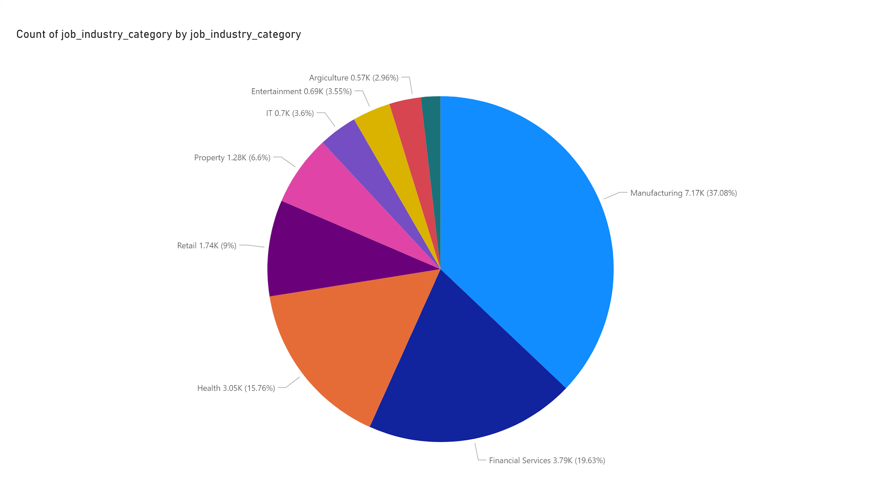
Notes:
Manufacturing has more employee than any job industries.

Slide 6
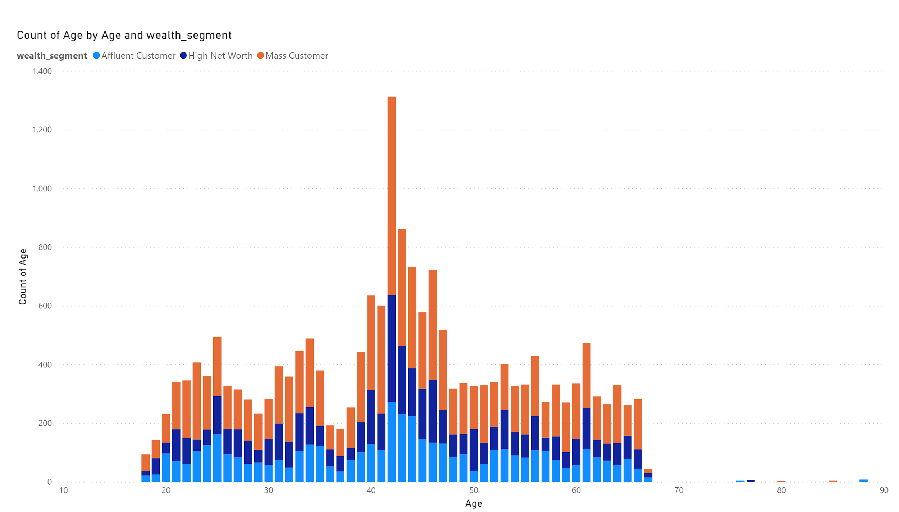

Slide 7
